Slide 1
Chapter 4: Threads & Concurrency

Slide 2
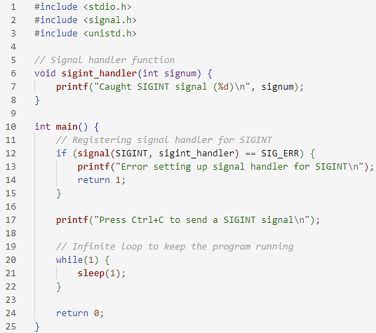
Signal Handling (Cont.)

Slide 3
Chapter 6: Synchronization Tools

Slide 4
Background
Processes can execute concurrently
May be interrupted at any time, partially completing execution
Concurrent access to shared data may result in data inconsistency
Maintaining data consistency requires mechanisms to ensure the orderly execution of cooperating processes
We illustrated in chapter 4 the problem when we considered the Bounded Buffer problem with use of a counter that is updated concurrently by the producer and consumer,. Which lead to race condition.

Slide 5
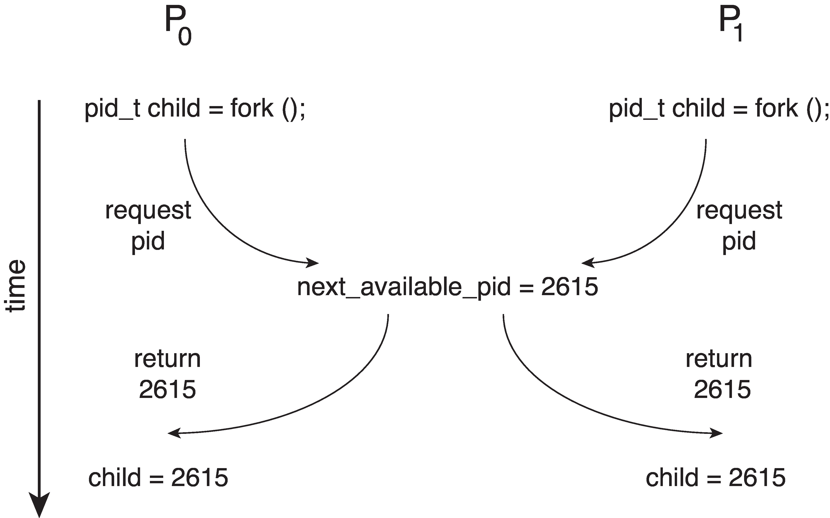
Race Condition
Processes P₀ and P₁ are creating child processes using the fork() system call
Race condition on kernel variable next_available_pid which represents the next available process identifier (pid)
Unless there is a mechanism to prevent P₀ and P₁ from accessing the variable next_available_pid the same pid could be assigned to two different processes!

Slide 6
Race Condition

